Slide 1
Arduino Workshop #6
The I²C bus
Notes:
24 – Arduino Uno
24 – USB Cable
24 – Red LED
72 – Yellow LED
96 – Green LED
192 – 220 Ω resistor
48 – 4.7 kΩ resistor
24 – SN74HC595N shift register DIP IC
24 – TC74A0-5.0V AT I2C Temperature sensor
24 – Jumper Wire sets
24 – Breadboards

Slide 2
PowerPoint and Code
Github.com/EELabMan
Go To Repositories and find Arduino 6 I2C bus

Slide 3
Standardizing Integrated Circuits
We will look at the common I²C protocol
Pronounced “eye squared see” or “eye two see”
Invented in the 1980’s by Philips
Allowed relatively low speed communications for various IC’s
Standardized in the 90’s
Other companies adopted and released compatible chips
Generally known as “two wire”
Because two wires lines are used for communications
Data and a clock
I²C is a trademarked name
Think Kleenex vs Tissues
If an electronic item says “two wire compatible” it will be fairly certain to be I²C compatible

Slide 4
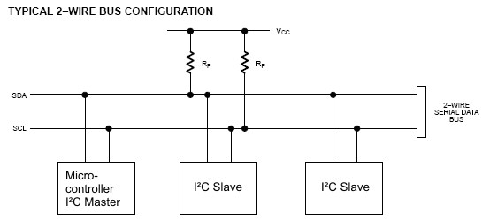
I²C Hardware Design
I²C is unique in that it can handle multiple devices
All share the same communication lines
A clock signal (SCL)
Bidirectional data line
Used to send data back and forth between the master and slave (SDA)
Notice that the I²C bus requires pull-up resistors on both data lines

Slide 5
Hardware and pull up resistors
The value of the needed pull up resistors
Depends on the slave devices
Number attached and individual needs
Specified on Data sheet
4.7 ㏀ is fairly standard (and what we will be using)

Slide 6
Communication Scheme and ID numbers
I²C can have multiple devices to share communication lines with a single “master” device
The Arduino will act as the master device
Responsible for initiating all communications
Slave devices can not initiate communication only respond to requests from the master
If not -- the communication line would be overwhelmed and data would drop

Slide 7
Naming and communication
Each slave device has a unique 7-bit address (ID)
Some I²C devices have selectable addresses
Some I²C devices have a fixed address (from the factory)
Temperature sensors are commonly preprogrammed with various IDs (to facilitate more than 1 sensor on a single bus)
When communication is initiated
An ID is transmitted
The slave device reacts to data on the bus only when it’s directed at their ID

Slide 8
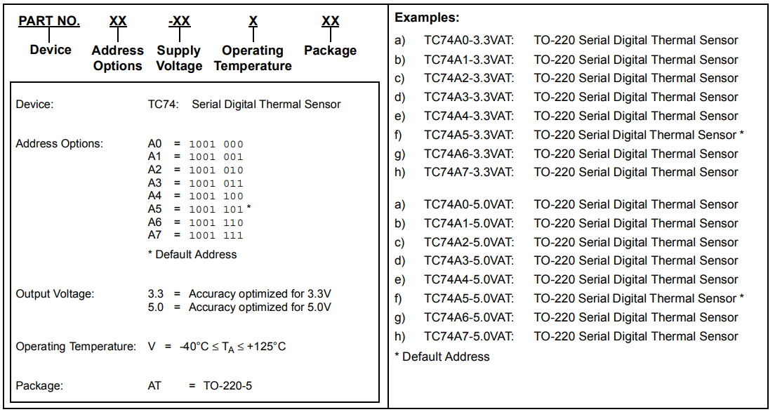
TC74 temperature sensor

Slide 9
Things to notice from the Data sheet
Notice from this manufacture
You can purchase eight different ID numbers
You could put 8 of them on 1 I²C chip and read them independently
As you are writing the program to interface w/ your temp sensor later… be aware of its ID

Slide 10
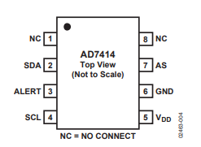
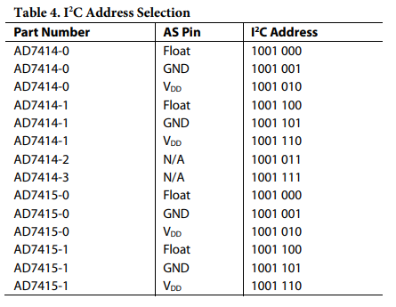
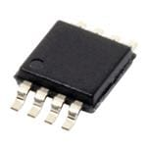
Address selectable I²C devices
Some chips (AD7414 and AD 7415) have address select (AS) pins
Allows you to configure the address of the device
Below we see AD7414 has an “AS” pin with 3 possible ID numbers
Depending on whether “AS” pin is left disconnected, is tied to VCC, or grounded
Board Mount Temperature Sensors SMBus / 12C 10-bit digital temp sensor I.C.

Slide 11
Communicating with I²C temp probe

Slide 12
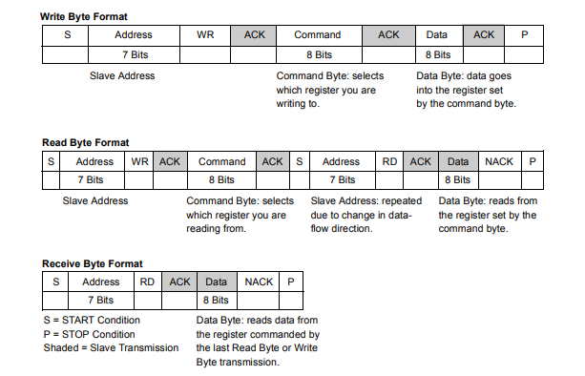
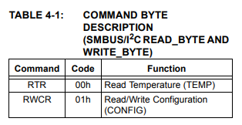
Before you can code an I²C device
You need to know the communication scheme
You need to know how to read the datasheet to determine this
Using what you already know about how I²C works
Notes:
Steps vary for different chips (with different requirements for different devices)
Thankfully Arduino I²C library can be used to abstract away most of the difficult timing work
Basic steps though are:
Master sends a start bit
Master sends 7-bit slave address of device it wants to talk to
Master sends read (1) or write (0) bit
Depending on the desired action
Slave responds with an “acknowledge” or ACK bit (a logic low)
Data is handled
In write mode
Master sends 1 byte of info at a time
Slave responds ACK
In Read mode
Master receives 1 byte of info at a time
Responds to slave with ACK

Slide 13
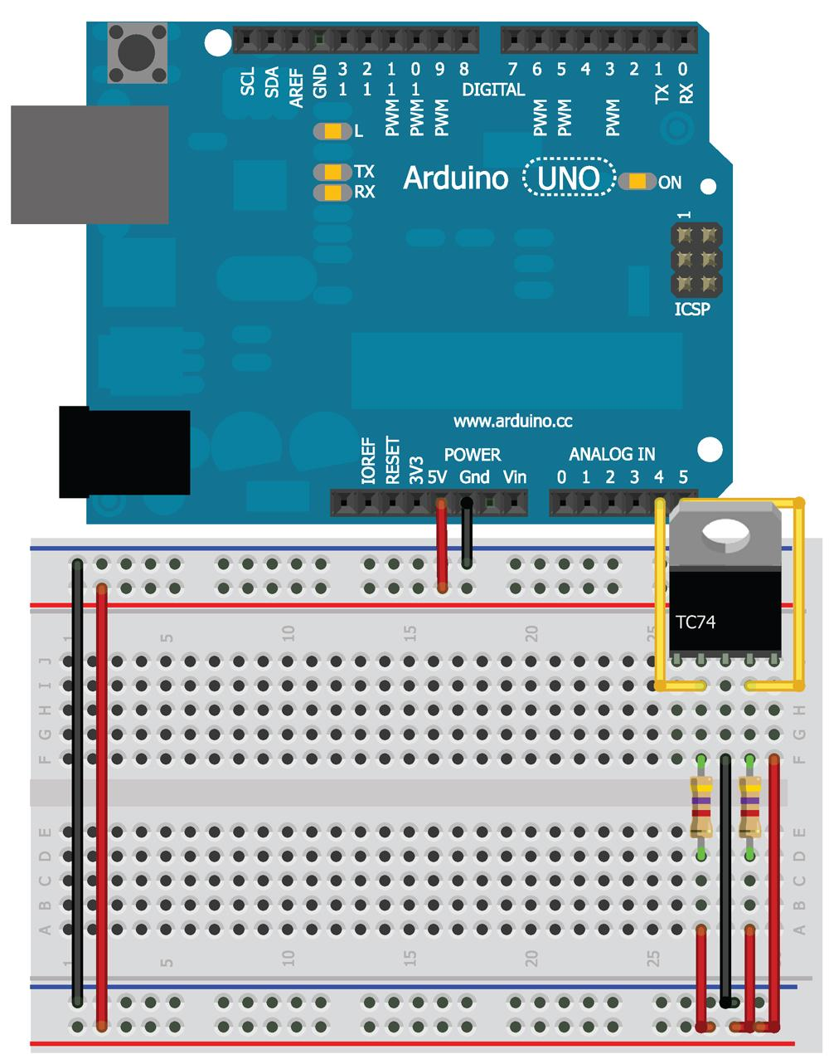
Wire it up

Slide 14
Things to note
You can use the serial to print out temps
It’s a digital signal
no conversion needed to see the data as a degree Celsius reading
SDA and SCL are wired to pins a4 and a5
They carry data and clock signal
Recall A4 and A5 are multiplexed pins
Between ADC and hardware I²C
When you initialize the wire library. Those pins connect to the ATMega’s I²C controller. Enabling with the Wire object to I²C device via those pins

Slide 15
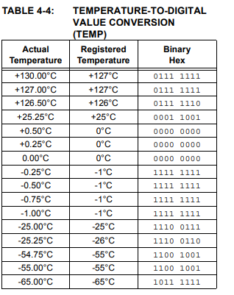
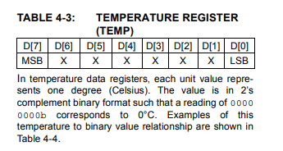
The takeaway from those two tables
You can both read and write to this I²C
As shown in the first table
The TC74 has 2 registers
Current temp (in ⁰C)
Contains configurable info about the chip (inc. standby state and data ready state)
In order to read the temp we can look at table 4-3 and 4-4
Notes:
2’s compliment - We need to base the code as an 8 bit 2’s compliment integer to read the sensor correctly.

Slide 16
Upload the read_temp.ino
#include <Wire.h>
int temp_address = 72; //1001000 written as decimal number
void setup()
{
//Start serial communication at 9600 baud
Serial.begin(9600);
//Create a Wire object
Wire.begin();
}

Slide 17
read_temp.ino Main Loop
void loop()
{
//Send a request
//Start talking to the device at the specified address
Wire.beginTransmission(temp_address);
//Send a bit asking for register zero, the data register
Wire.write(0);
//Complete Transmission
Wire.endTransmission();
//Read the temperature from the device
//Request 1 Byte from the specified address
Wire.requestFrom(temp_address, 1);
//wait for response

Slide 18
read_temp.ino Main Loop cont.
while(Wire.available() == 0);
// Get the temp and read it into a variable
int8_t c = Wire.read();
//Do some math to convert the Celsius to Fahrenheit
int8_t f = round(c*9.0/5.0 +32.0);
//Send the temperature in degrees C and F to the serial monitor
Serial.print(c);
Serial.print("C ");
Serial.print(f);
Serial.println("F");
delay(500);
}

Slide 19
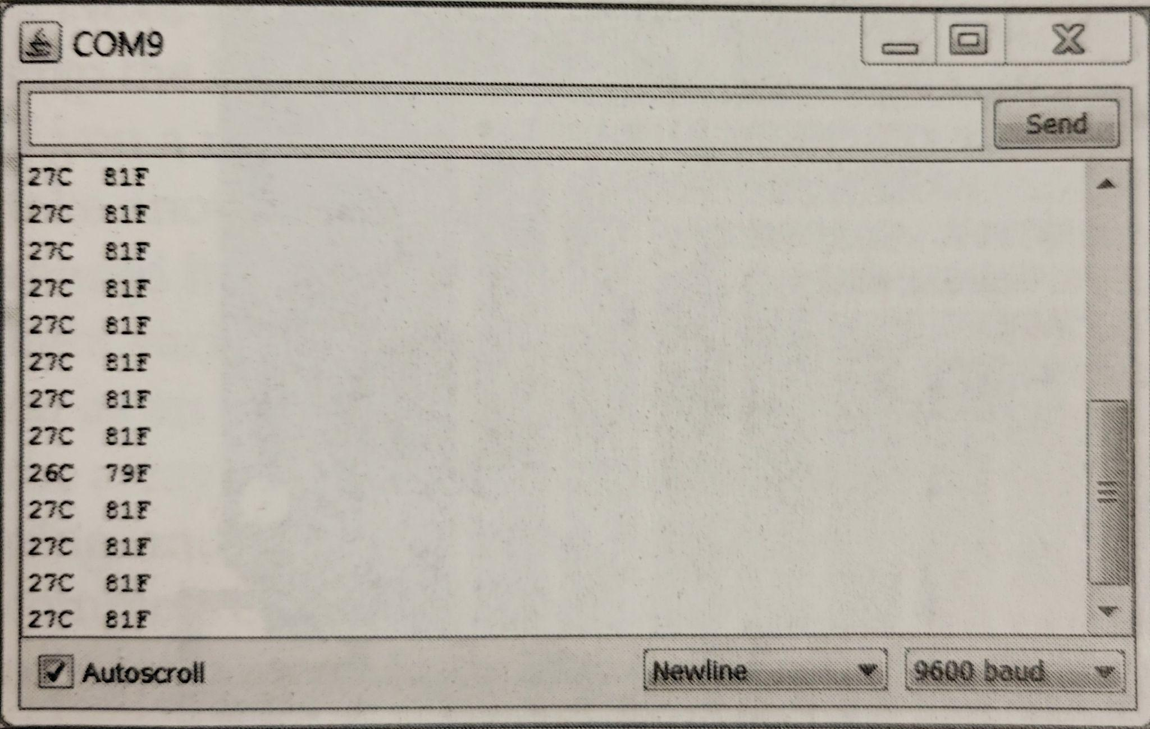
What you should see in the Serial Monitor
Notes:
Get the circuit chiller to test the negative numbers.

Slide 20
Temp monitoring system

Slide 21
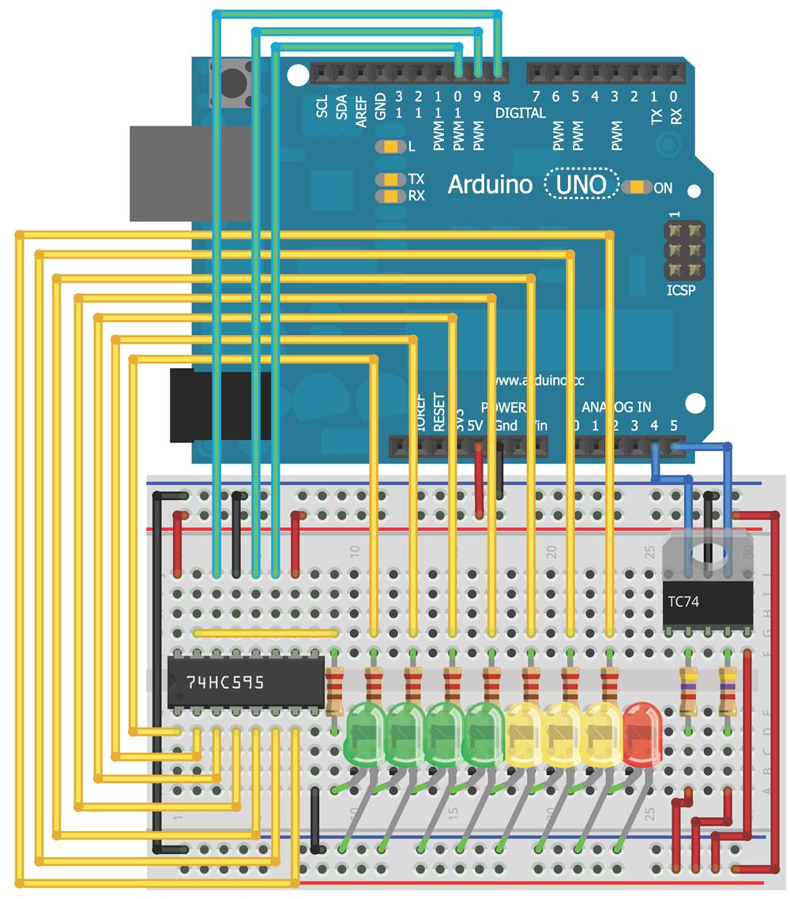
Wire the arduino

Slide 22
Minor modification of previous program
The print statements should read
Serial.print(c);
Serial.print(“C,”);
Serial.print(f);
Serial.print(“F.”);
This allows you to easily parse the temps by the delimiting character (“,” and “.” respectively)
Next we need to add a shift register code (from last session)and mao the LEDs to the appropriate levels (the code given chose 24⁰C to 31⁰C but you can choose any level that works best for the room)

Slide 23
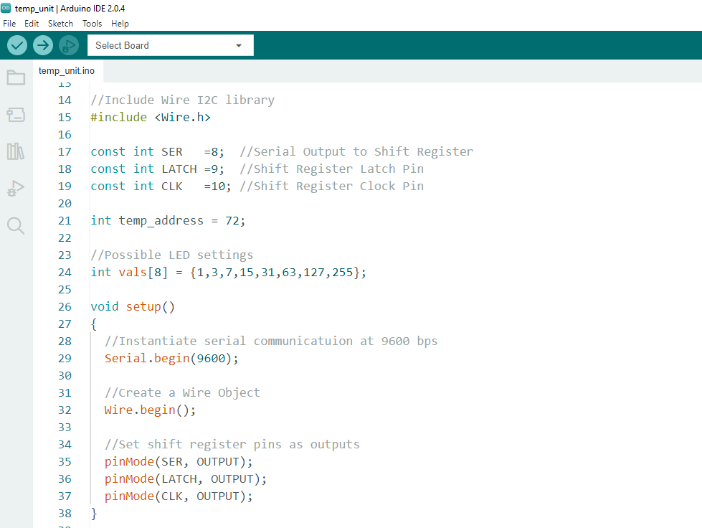
Download temp_unit.ino from GitHub
Notes:
Click to open file

Slide 24
You should see
The LEDs light up and if you squeeze the temp sensor with your fingers making the temp go up, the LED’s should respond

Slide 25
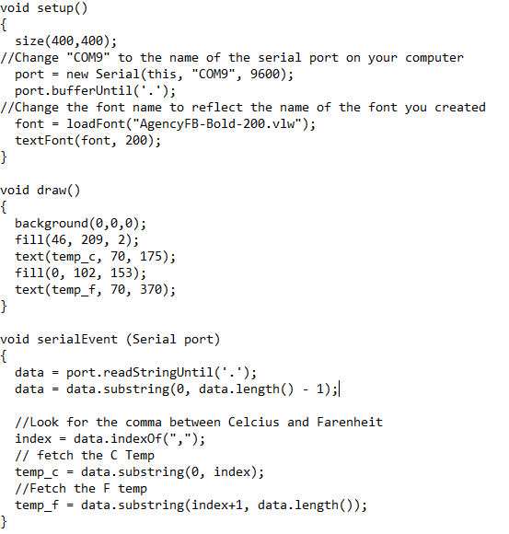
Writing a Process sketch
Download from GitHub
Things to change
The com port needs to match the computer
Pick a font you enjoy
Pick a font size that you want
Arduino Serial Monitor must be closed

Slide 26
Stay tuned
Arduino 7 will cover the SPI bus.
We’ll wire two Digital Potentiometers!

